Slide 1

Marketing the Ford Ka
Compare Clustering Solutions
Demographics versus Psychographics

Slide 2
Visualizing our Data
We find some interesting patterns in the data:
Viriginica’s have longer and wider Petals
Setosa’s have short and narrow Petals, but their Sepals are wide (but shorter)
Versicolor’s are in between, but are more like Virginica’s than Setosa’s

Slide 3

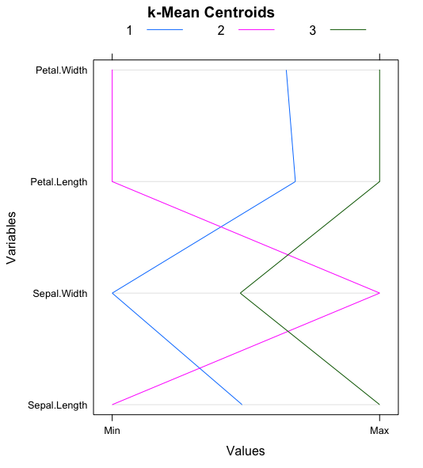
Customer Segmentation
What are your clusters?
What do your clusters mean?
Cluster | Meaning
1 | Long petaled flowers best for hillsides
2 | Medium flowers useful for massing
3 | Small flowers great near homes
State this in plain words that non-technical users can understand. Try using pictures or labels to summarize each cluster.
Experiment with tables and graphs to illustrate and contrast the clusters

Slide 4
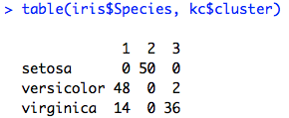
Recommendation of Clustering Solution
There is a strong association between the cluster solution and the species of Iris.
Our confusion matrix shows a strong relationship between “1” and versicolor, “2” and setosa, and “3” and virginica
The validity of our clustering solution is demonstrated by our ability predict the taxonomy developed by expert botanists.

